Slide 1
Linear Time Algorithms for Finding and Representing all Tandem Repeats in a String
Dan Gusfield and Jens Stoye
Journal of Computer and System Science 69 (2004) 525-546
Presenter: Yung-Hsing Peng
Date: 2005.07.15

Slide 2
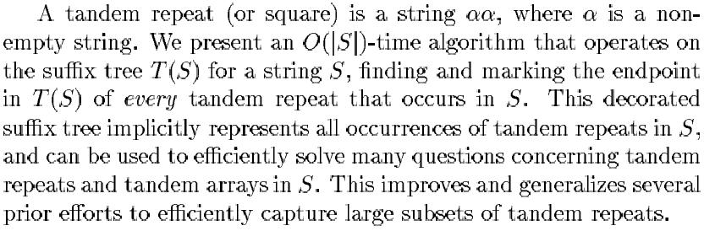
Abstract

Slide 3
Motivation
Recently it was shown that the number of different types of tandem repeats contained in a string of length n is bounded by O(n) [FS98]
Can we find one occurrence of each tandem repeat type in O(n) time? Such a list of different repeat types is called the vocabulary of string S.

Slide 4
An Example for Vocabulary
For example, a vocabulary of tandem repeats of the string abaabaabbaaabaaba$ is given by a set of pairs {(1, 6), (2, 6), (3, 2), (3, 6), (8, 2)} representing the tandem repeats abaaba, baabaa, aa, aabaab, bb.
In above example, the set of occurrences of tandem repeats is {(1, 6), (2, 6), (3, 2), (3, 6), (6, 2), (8, 2), (10, 2), (11, 2), (11, 6), (12, 6), (14, 2)}
In this paper, we present an algorithm that finds the vocabulary of a string S of length n in O(n) time and space, by decorating the suffix tree of S.

Slide 5
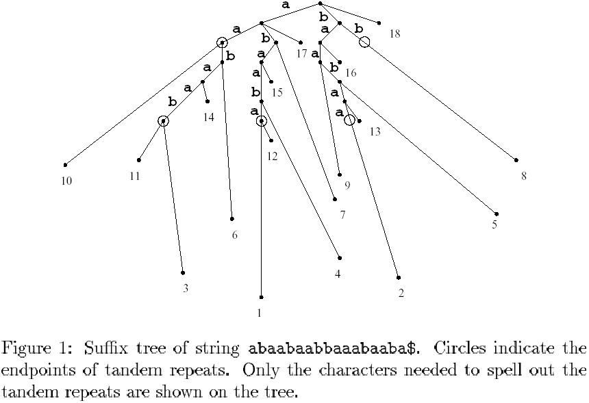
Example for Our Goal

Slide 6
Basic Knowledge
If a string aw is a tandem repeat, then the string wa is also a tandem repeat, where ‘a’ is a single character and w is a string.
An interval of positions i, i+1,…, j is called a run of l-length tandem repeats if (i, l), (i+1, l),…, (j, l) are each tandem repeat pairs. In this case, we say that (i, l) covers (i+1, l), (i+2, l)… (j, l).
If (i, l) covers (j, l), then the substring S[j..j+l-1] can be obtained by a series of successive right-rotations from the substring S[i..i+l-1]

Slide 7
The Leftmost Covering Set
A set of pairs P is a leftmost covering set, if the leftmost occurrence of each type of tandem repeat in S is covered by a pair.
For example, {(1, 6), (8, 2), (11, 2)} is a covering set of abaabaabbaaabaaba$, but is not a leftmost covering set since the leftmost occurrence of aa at position 3 is not covered. However, {(1, 6), (3, 2), (8, 2)} is a leftmost covering set.
Note that the vocabulary set is {(1, 6), (2, 6), (3, 6), (3, 2), (8, 2)}, and both (3, 2) and (11, 2) represent aa.

Slide 8
Main Idea
Our goal can be achieved using a three-phase procedure.
Phase I: Find the leftmost covering set.
Phase II: Decorate the suffix tree using leftmost covering set.
Phase III: Traverse the suffix tree and decorate the vocabulary set to the suffix tree.

Slide 9
Useful Tools for Phase I
Two crucial tools are needed in Phase I. The first is the Lempel-Ziv (LZ) decomposition, and the second is the repeated use of longest common extension queries.
Using these two crucial tools, we can find the leftmost covering set of a string S, in O(n) time and space.

Slide 10
Longest Common Extension
Given two strings S1,S2 with length m and n, the longest common extension of a pair (i, j) is the length of the longest common prefix of S1[i…m] and S2[j…n].
This problem can be solved in constant time, after an O(n) time and space preprocessing. [Gus97]
With this powerful tool, one can easily find all tandem repeats in O(n²) by discussing all possible length of tandem repeats in every location, so called brute force.
However, we can reduce the time to O(n) by combining another good tool, called LZ decomposition.

Slide 11
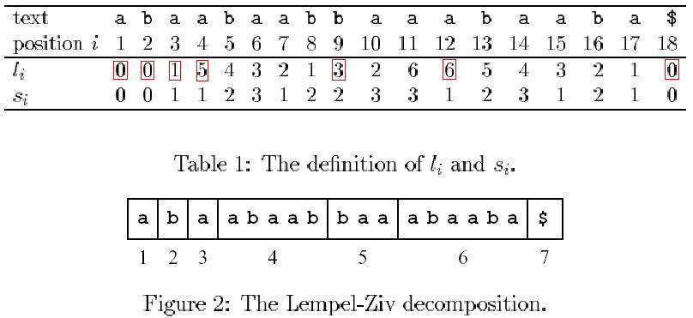
Lempel-Ziv decomposition
l_{i} : the length of prefix
S_{i} : the starting position.
After we compute every l_{i} and s_{i}, we can use the formula i_{B+1}=i_{B}+max(1, l_{iB}) to decompose the string S (red square represents the l_{i} discussed). All computation can be done in O(n) [RPE81]

Slide 12
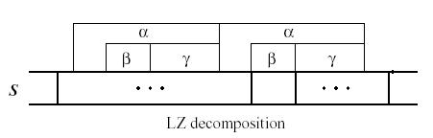
Usefulness of LZ decomposition(1/2)
The right half of any tandem repeat occurrence must touch at most two blocks of the LZ decomposition, otherwise the decomposition must be wrong. (A contradiction below)
The leftmost occurrence of any tandem repeat must touch at least two blocks, otherwise there must be another same tandem repeat in the left side (Any substring in a single block must appear in the left side)

Slide 13
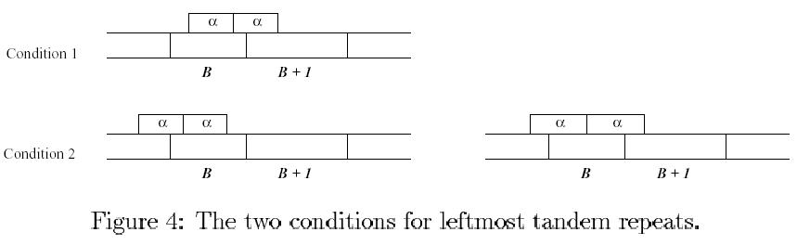
Usefulness of LZ decomposition(2/2)
There are two conditions to discuss: (1) The left half of the tandem repeat touches exactly one block. (2) The left half of the tandem repeat touches more than one block.
It implies that the length of a tandem repeat is block-dependent, hence we don’t need to discuss the length brutally from 1 to n, at every location.

Slide 14
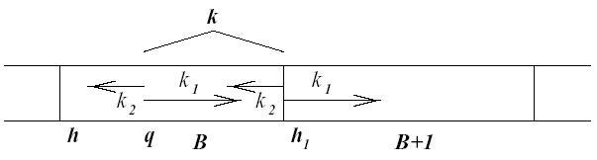
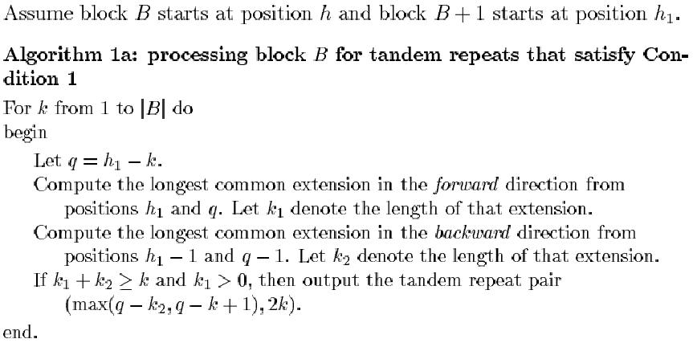
Algorithm for Condition 1
The length of the tandem repeat is 2k.

Slide 15
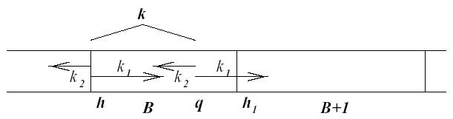
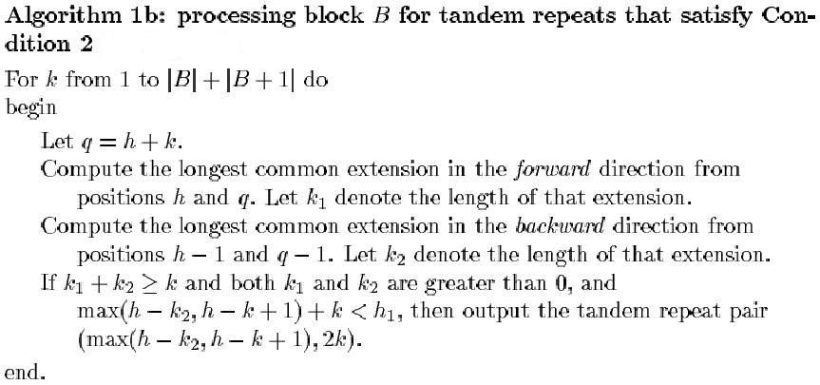
Algorithm for Condition 2

Slide 16
The End of Phase I
Now we have found the leftmost covering set.
Algorithm 1a and 1b both run in O(n), since the blocks are non-overlapping and these algorithms process the blocks one by one, each for O(|B|).
All tools (LZ decomposition + longest common extension) run in O(n)
We can find the leftmost covering set of a string S with its length n, in O(n) time.

Slide 17
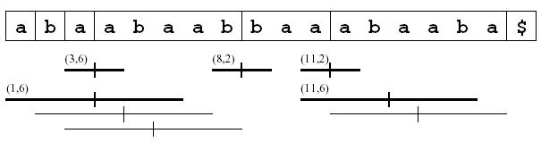
Phase II
After Phase I, we can obtain the leftmost covering set above (Note that it was sorted in Phase I). What we have to do now is to decorate the suffix tree with these pairs.
Hint: Attach them to the leaves first, then use the bottom-up strategy.
Please read the paper for detailed illustration.

Slide 18
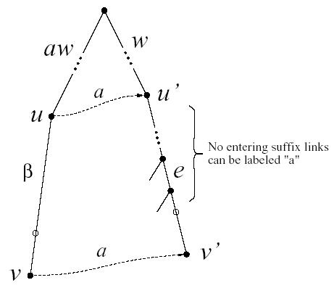
A Useful Tool in Phase III
You can jump from ax to xa more quickly, since you can jump from ax to x directly by using the suffix link labeled ‘a’.

Slide 19
Phase III
Use DFS search to get every decorated pairs.
For every decorated pairs, use the suffix link to do the “right-rotation” mentioned before (to extend the run).
If the right-rotation fail or collide with another decorated pair, it means the run of this pair is ended.
Phase III can also be done in O(n), because it use the suffix link to speed up the rotation time (every rotation can be done in constant time).
Please read the paper for detailed illustration.

Slide 20
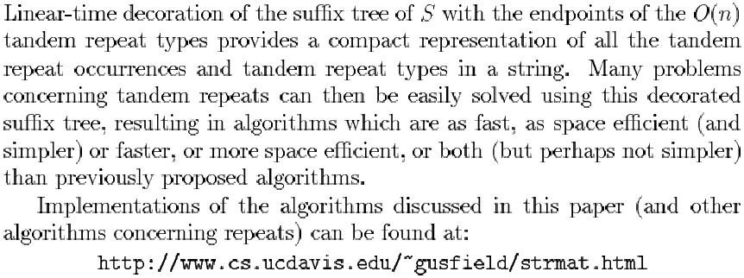
Conclusion

Slide 21
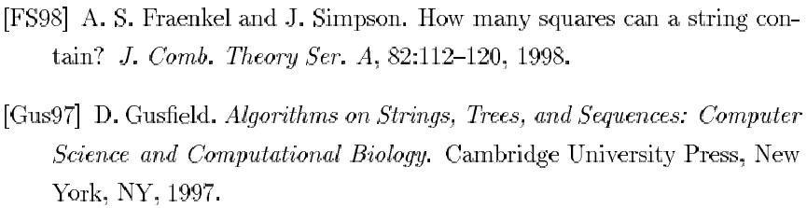
Reference

